Slide 1
Time lapse photomapping
Taking photos while driving, safely
SOTM-US 2012
Notes:
Hello
Name
Introduce self
Here to talk about ogr2osm

Slide 2
Basic idea
Take photos while driving normally
Hands-free

Slide 3
Hardware needed
A GPS
A GPS plugged into the car power socket works best

Slide 4
Hardware needed
A camera with time lapse functionality

Slide 5
Camera selection
A intervalometer function is needed
Found on GoPro cameras, Canon Powershots with CHKD firmware, some high-end cameras
GoPro for bikes
GoPro or Powershot for cars

Slide 6
Camera selection
Images are taken while moving, so good high-ISO performance is a plus
Long battery life when taking lots of photos
Tripod mount

Slide 7
Camera selection
Wide-angle gets you more of the view per picture
Typically either lower quality or expensive lenses
Found on GoPro

Slide 8
Camera selection
Narrower angle gets you street signs farther away
Generally less expensive
Found on point and shoot

Slide 9
Where to aim?
Forwards
Sideways
Same view as you have driving
Good for street signs
Minimal motion blur
Different view
Good for POIs
Motion blur increases with speed
Not suggested for highway driving

Slide 10
Other tips
Use manual focus or distance override
Higher up gets you better views but might be in your way

Slide 11
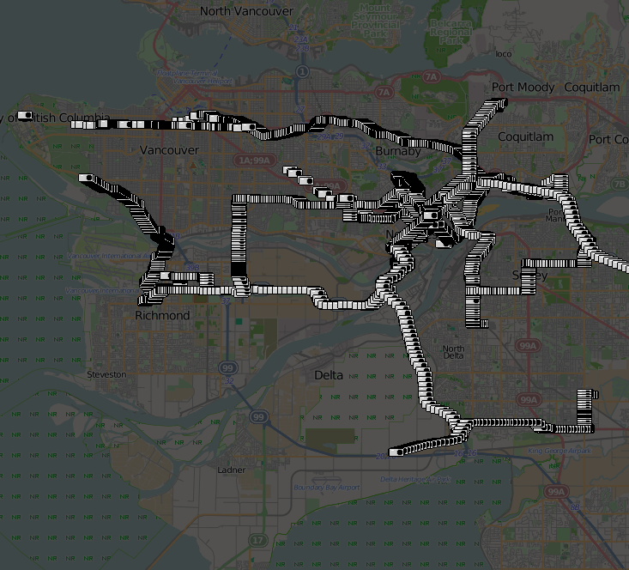
Viewing Photos
Use JOSM to correlate to GPX files and geotag

Slide 17
Credits
Background by Stamen Design under CC BY 3.0
GPS image © Chase N, CC BY-SA 2.0, from flickr
Powershot A470 image © fsse8info, CC BY-SA 2.0, from flickr

