Slide 1
Ogr2osm
A powerful tool for converting geodata to .osm format
SOTM-US 2012
Notes:
Hello
Name
Introduce self
Here to talk about ogr2osm

Slide 2
About
What ogr2osm can do for you
How ogr2osm works
A case study of a data conversion
Why care about converting?
Notes:
I’ll talk aboutwhat ogr2osm can do for you
How it works
Present a case study
But first, why care?

Slide 3
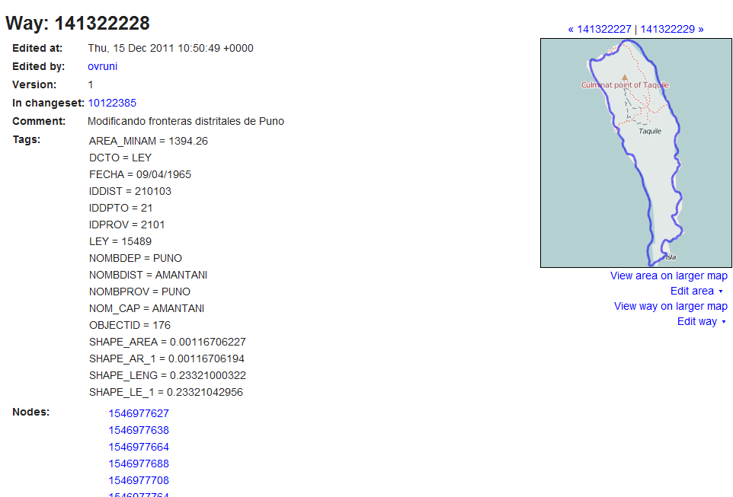
Why care? To avoid this
Notes:
This is why you should care
I wish I could say problems like this are uncommon but it didn’t take long for my database to find ways with over 300 tags from bad imports
Imports like this are useless with no osm tags and even if they include some osm tags the number of confusing tags puts new mappers off

Slide 4
History
Written in 2009 by Iván Sánchez Ortega
Rewritten 2012 by Andrew Guertin for UVM buildings
I now maintain it
Notes:
I did not start ogr2osm but I have taken over maintenance of it

Slide 5
Features
Can read any ogr supported data source
  .shp, .mdb, .gdb, sqlite, etc
Reprojects if necessary – eliminates a step with many sources
Works with multiple layer sources or shapefile directories
Uses python translation functions that you write to convert source field values to OSM tags
  This allows you to use complicated logic to get the tagging right
Documentation
Notes:
Ogr2osm has some features that make it superior to other general-purpose shapefile and geodata converters
Because it uses ogr it can read virtually any file format. About the only format it doesn’t support is a postgis db but that can be easily added if someone wants it
It reprojects to WGS84, saving a step with ogr2ogr with most sources
It will work with multi-layer sources, correctly combining shared nodes across layers with an error tolerance
And most importantly, you can use python functions to convert datasource tags to OSM tags
Lastly, it comes with some documentation

Slide 6
Installing
Requires gdal with python bindings
  Simply sudo apt-get install python-gdal git on Ubuntu
  May require compiling gdal from source and third-party SDKs for some formats (.mdb, .gdb)
Run git clone --recursive https://github.com/pnorman/ogr2osm to install
Full instructions at https://github.com/pnorman/ogr2osm
Notes:
Installing ogr2osm is fairly easy. The only dependencies are python and gdal with python bindings. Git is required to install it and the translations
Should mention Translations are their own git sub-module. This makes it possible to use your own repo for the translations without touching ogr2osm itself

Slide 7
Code flow
Read in data source
Process each layer
Converts from ogr to osm tagging and objects
Merge nodes
Merges duplicate nodes
preOutputTransform()
A user-defined filtering step, not commonly used
Output XML
Write to a .osm file that can be opened in JOSM
Adjustable threshold for distance
Uses python ogr bindings to read the files
Notes:
The easiest way for me to explain how ogr2osm works is to briefly run through the code execution

Slide 8
Code flow
Read in data source
Process each layer
Converts from ogr to osm tagging and objects
Merge nodes
Merges duplicate nodes
preOutputTransform()
A user-defined filtering step, not commonly used
Output XML
Write to a .osm file that can be opened in JOSM
Adjustable threshold for distance
Uses python ogr bindings to read the files
Notes:
First the file is read in
By default it reads with OGR it and it makes an in-memory copy of it

Slide 9
Code flow
Read in data source
Process each layer
Converts from ogr to osm tagging and objects
Merge nodes
Merges duplicate nodes
preOutputTransform()
A user-defined filtering step, not commonly used
Output XML
Write to a .osm file that can be opened in JOSM
Adjustable threshold for distance
Uses python ogr bindings to read the files
Notes:
Then it works on each layer
Often there is just one layer but it will handle multiple ones

Slide 10
Layer processing
filterLayer()
Allows layers to be dropped
Allows for the creation of new fields
e.g. a field that indicates the layer of a feature for later
Reproject
Projects the layer into EPSG:4326
filterFeature()
Allows features to be removed
Reproject
Projects the feature into EPSG:4326
Convert to OSM geometries
Creates nodes and ways
filterTags()
filterFeaturePost()
Only creates multipolygons if necessary
Where all the magic occurs
A user-defined filtering step, not commonly used
Notes:
A sequence of steps happens for each layer

Slide 11
Layer processing
filterLayer()
Allows layers to be dropped
Allows for the creation of new fields
e.g. a field that indicates the layer of a feature for later
Reproject
Projects the layer into EPSG:4326
filterFeature()
Allows features to be removed
Reproject
Projects the feature into EPSG:4326
Convert to OSM geometries
Creates nodes and ways
filterTags()
filterFeaturePost()
Only creates multipolygons if necessary
Where all the magic occurs
A user-defined filtering step, not commonly used
Notes:
The first step for processing the layer is passing the layer through the filterLayer translation function
This is a function that you can write
There are two common uses
The first is to drop layers that you don’t want to convert to osm for importing
The second is to add new fields to the layer and to add fields to objects indicating what layer they’re from for later on

Slide 12
Layer processing
filterLayer()
Allows layers to be dropped
Allows for the creation of new fields
e.g. a field that indicates the layer of a feature for later
Reproject
Projects the layer into EPSG:4326
filterFeature()
Allows features to be removed
Reproject
Projects the feature into EPSG:4326
Convert to OSM geometries
Creates nodes and ways
filterTags()
filterFeaturePost()
Only creates multipolygons if necessary
Where all the magic occurs
A user-defined filtering step, not commonly used
Notes:
The next step is to reproject the layer to EPSG:4326 that OSM uses
Ogr does all the work here so not much to say
---
Next is filterFeature()
Another user defined function
Most common use is to drop features that you aren’t interested
---
Each feature is turned from an ogr object into osm nodes ways and MPs
This is where the bulk of the code is
Ogr2osm will only create multipolygons if absolutely necessary. The old SVN version did so whenever there were overlapping ways but the new one does not do so.
Intend to add this as an option
It will handle stuff like multilinestrings without problems
If you’re only using and not developing the details don’t matter too much
---
Next is the filterTags() function
This is the most important user defined function. It turns source attributions into OSM tags and it’s up to you to write it. The use of a function allows complicated logic and stuff like name expansion
---
filterFeaturePost is another not commonly used function. UVM uses these for buildings in a fairly complicated way.
--- You then repeat for each

Slide 13
Layer processing
filterLayer()
Allows layers to be dropped
Allows for the creation of new fields
e.g. a field that indicates the layer of a feature for later
Reproject
Projects the layer into EPSG:4326
filterFeature()
Allows features to be removed
Reproject
Projects the feature into EPSG:4326
Convert to OSM geometries
Creates nodes and ways
filterTags()
filterFeaturePost()
Only creates multipolygons if necessary
Where all the magic occurs
A user-defined filtering step, not commonly used
Notes:
Next is filterFeature()
Another user defined function
Most common use is to drop features that you aren’t interested

Slide 14
Layer processing
filterLayer()
Allows layers to be dropped
Allows for the creation of new fields
e.g. a field that indicates the layer of a feature for later
Reproject
Projects the layer into EPSG:4326
filterFeature()
Allows features to be removed
Reproject
Projects the feature into EPSG:4326
Convert to OSM geometries
Creates nodes and ways
filterTags()
filterFeaturePost()
Only creates multipolygons if necessary
Where all the magic occurs
A user-defined filtering step, not commonly used
Notes:
In addition to each layer the features also need to be turned into EPSG:4326. not much to say here either

Slide 15
Layer processing
filterLayer()
Allows layers to be dropped
Allows for the creation of new fields
e.g. a field that indicates the layer of a feature for later
Reproject
Projects the layer into EPSG:4326
filterFeature()
Allows features to be removed
Reproject
Projects the feature into EPSG:4326
Convert to OSM geometries
Creates nodes and ways
filterTags()
filterFeaturePost()
Only creates multipolygons if necessary
Where all the magic occurs
A user-defined filtering step, not commonly used
Notes:
Each feature is turned from an ogr object into osm nodes ways and MPs
This is where the bulk of the code is
Ogr2osm will only create multipolygons if absolutely necessary. The old SVN version did so whenever there were overlapping ways but the new one does not do so.
Intend to add this as an option
It will handle stuff like multilinestrings without problems
If you’re only using and not developing the details don’t matter too much

Slide 16
Layer processing
filterLayer()
Allows layers to be dropped
Allows for the creation of new fields
e.g. a field that indicates the layer of a feature for later
Reproject
Projects the layer into EPSG:4326
filterFeature()
Allows features to be removed
Reproject
Projects the feature into EPSG:4326
Convert to OSM geometries
Creates nodes and ways
filterTags()
filterFeaturePost()
Only creates multipolygons if necessary
Where all the magic occurs
A user-defined filtering step, not commonly used
Notes:
Next is the filterTags() function
This is the most important user defined function. It turns source attributions into OSM tags and it’s up to you to write it. The use of a function allows complicated logic and stuff like name expansion
As it’s one argument it is passed a dictionary which is the fields on the feature and it returns another dictionary which is the OSM tags

Slide 17
Layer processing
filterLayer()
Allows layers to be dropped
Allows for the creation of new fields
e.g. a field that indicates the layer of a feature for later
Reproject
Projects the layer into EPSG:4326
filterFeature()
Allows features to be removed
Reproject
Projects the feature into EPSG:4326
Convert to OSM geometries
Creates nodes and ways
filterTags()
filterFeaturePost()
Only creates multipolygons if necessary
Where all the magic occurs
A user-defined filtering step, not commonly used
Notes:
filterFeaturePost is another not commonly used function. UVM uses these for buildings in a fairly complicated way.
--- You then repeat for each

Slide 18
Layer processing
filterLayer()
Allows layers to be dropped
Allows for the creation of new fields
e.g. a field that indicates the layer of a feature for later
Reproject
Projects the layer into EPSG:4326
filterFeature()
Allows features to be removed
Reproject
Projects the feature into EPSG:4326
Convert to OSM geometries
Creates nodes and ways
filterTags()
filterFeaturePost()
Only creates multipolygons if necessary
Where all the magic occurs
A user-defined filtering step, not commonly used
Notes:
You then repeat for each

Slide 19
Code flow
Read in data source
Process each layer
Converts from ogr to osm tagging and objects
Merge nodes
Merges duplicate nodes
preOutputTransform()
A user-defined filtering step, not commonly used
Output XML
Write to a .osm file that can be opened in JOSM
Adjustable threshold for distance
Uses python ogr bindings to read the files

Slide 20
Code flow
Read in data source
Process each layer
Converts from ogr to osm tagging and objects
Merge nodes
Merges duplicate nodes
preOutputTransform()
A user-defined filtering step, not commonly used
Output XML
Write to a .osm file that can be opened in JOSM
Adjustable threshold for distance
Uses python ogr bindings to read the files

Slide 21
Code flow
Read in data source
Process each layer
Converts from ogr to osm tagging and objects
Merge nodes
Merges duplicate nodes
preOutputTransform()
A user-defined filtering step, not commonly used
Output XML
Write to a .osm file that can be opened in JOSM
Adjustable threshold for distance
Uses python ogr bindings to read the files

Slide 22
Surrey case study
Shapefile fields similar to other government GIS sources
Fields or values periodically change with no notice
58 layers in 7 zip files
  Not counting orthos and LIDAR-derived contours
153 MB compressed, 1.7 GB uncompressed
Covers 187 km²
Too much data to write conversions for without a method
Notes:
As an example of writing translations, I have a case study of data from the City of Surrey that I’ve been working on
This is a large and extremely detailed data set
I should mention that converting the data is only half the problem. Once it’s converted you have to figure out how to best use the data, but that’s another talk in itself
Although I am looking at one specific dataset most government datasets are fairly similar in what they tag and how their taggings don’t exactly correspond to OSM taggings
What do I mean by a lot of data?

Slide 23
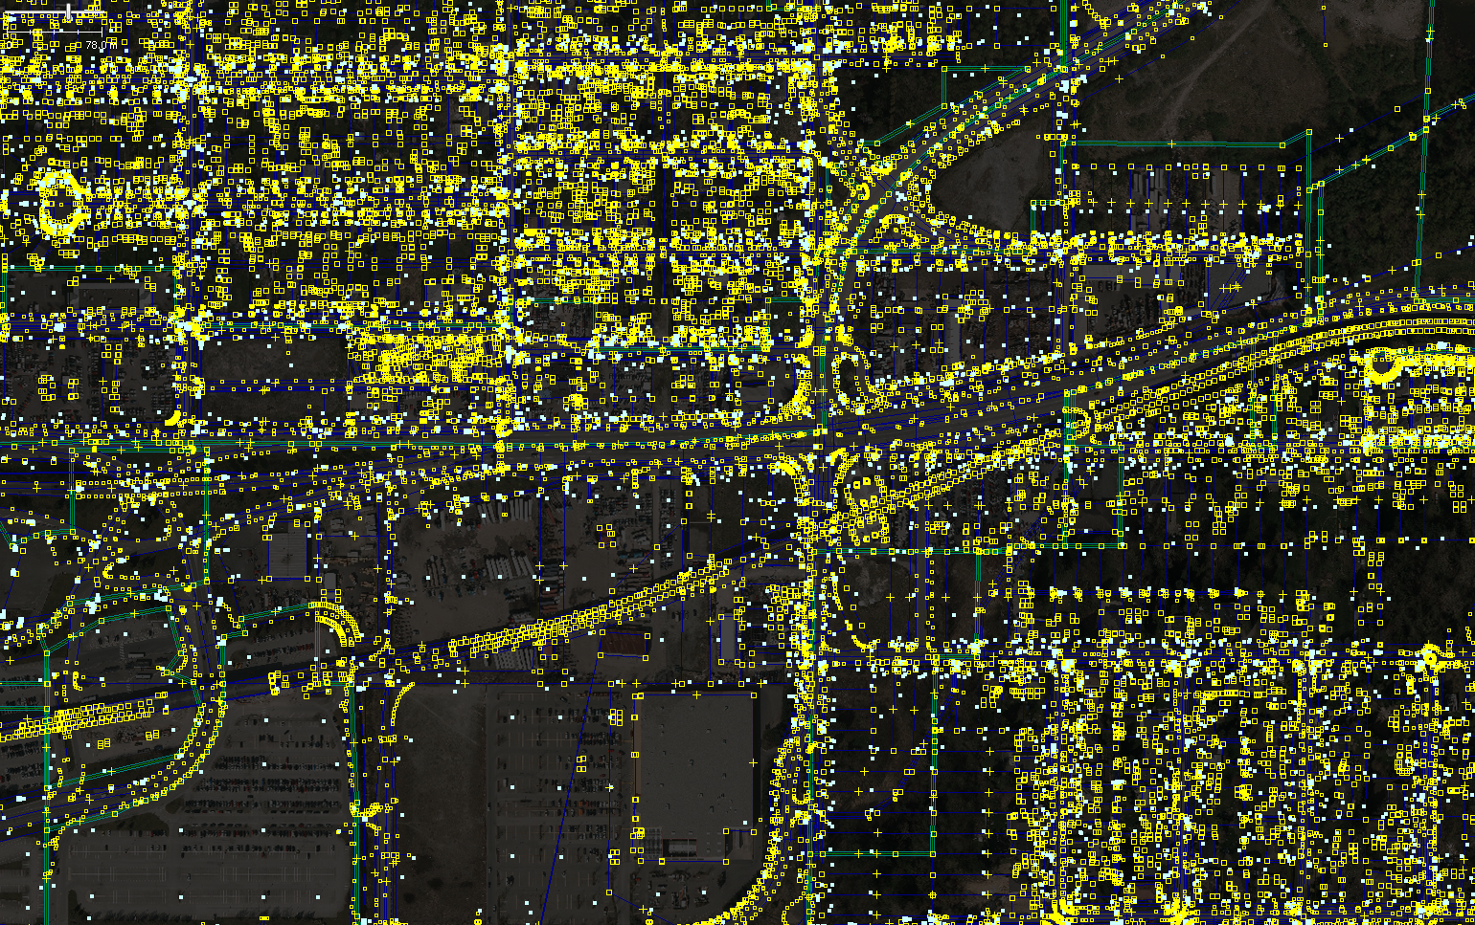
Notes:
This is about 10x5 city blocks, about 40 hectares. As you can see, there’s a lot of data

Slide 24
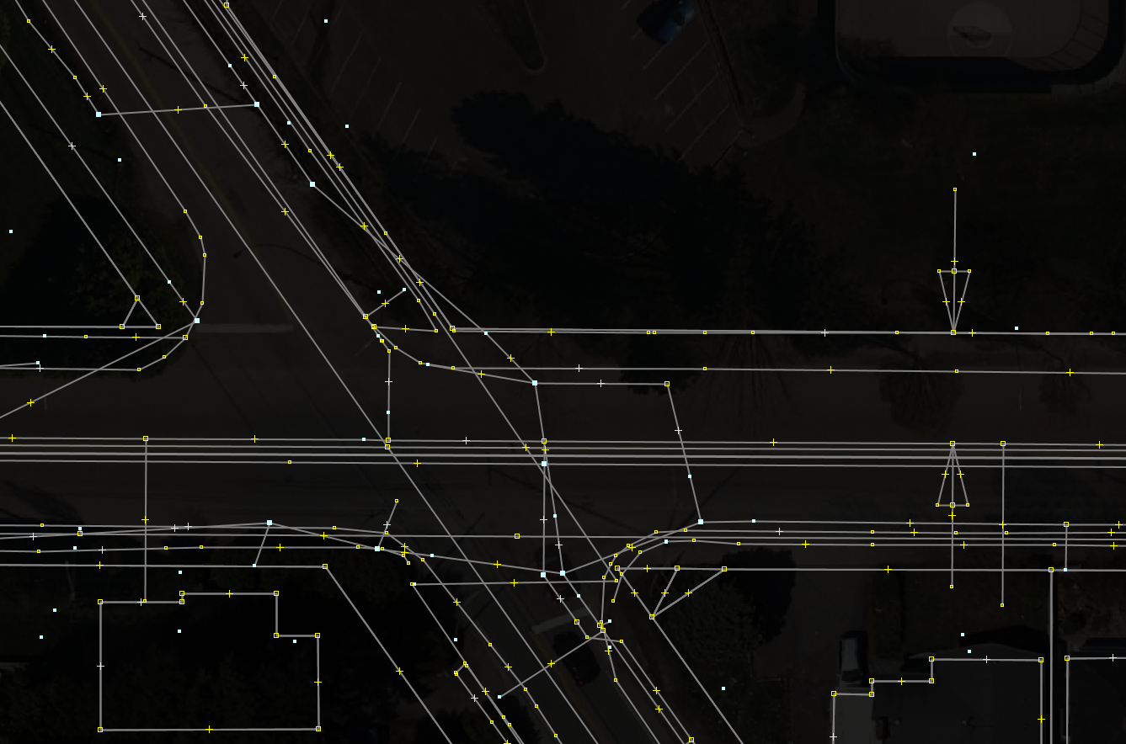
Notes:
This is one corner showing how much data there is to sort through, but I won’t go over all of it here

Slide 25
Reduce the amount of data
ogr2osm will happily turn out a gigabyte .osm but good luck opening it
Use ogr2ogr -spat to trim the input files down
  Converting from some formats to shapefiles will truncate field names
    Can use .gdb when coming from a format with long field names and layers
  -spat wants coordinates in layer coordinate system
    Use gdaltransform to turn latitude/longitude into desired coordinates
Notes:
The first step is generally to clip the data to a smaller area
ogr2osm will deal with gigabyte .osm files but normally you want to load these up into JOSM which doesn’t work so well
Ogr2ogr can trim the files down to an area, but you need to be aware of a couple gotchas
If your source is .mdb or something that supports long field names converting to a shapefile will truncate them
You also have to deal with coordinate systems. I have a one line command in my speaker’s notes that will be up later that does this
I have a one-line ogr2ogr command in my notes that handles
ogr2ogr -progress -spat `echo "-122.89 49.18" | gdaltransform -s_srs EPSG:4326 -t_srs EPSG:26910 | cut -d \ -f 1,2` `echo "-122.85 49.22" | gdaltransform -s_srs EPSG:4326 -t_srs EPSG:26910 | cut -d \ -f 1,2` SurreyData_clip SurreyData

Slide 26
Drop layers
Use the layer translation (-t layer) and see what layers should be dropped
Most multi-layer sources have layers that should not be imported
In the case of the Surrey data filtering is done in the script that downloads the data
def filterLayer(layer):
layername = layer.GetName()
if layername in ('WBD_HU2', 'WBD_HU4', 'WBD_HU6'):
return
if layername not in ('NHDArea', 'NHDAreaEventFC'):
print 'Unknown layer ' + layer.GetName()
field = ogr.FieldDefn('__LAYER', ogr.OFTString)
field.SetWidth(len(layername))
layer.CreateField(field)
for j in range(layer.GetFeatureCount()):
ogrfeature = layer.GetNextFeature()
ogrfeature.SetField('__LAYER', layername)
layer.SetFeature(ogrfeature)
layer.ResetReading()
return layer
Notes:
The first step is to see what layers you can drop
The easiest way to do this is use the layer translation and open the resulting .osm file
I’m have scripting for the surrey example before it makes it to ogr2osm that removes the undesired layers so this example is actually from a NHD translation
It removes some layers which indicate NHD subbasin divisions which don’t correspond to anything physical
It also adds a __LAYER field which is needed to identify which layer a feature comes from

Slide 27
Writing a good filterTags(attrs)
When testing you want unknown fields to be kept
Delete items from attrs as you convert them to OSM tags
Delete fields which shouldn’t be converted to an OSM tag
def filterTags(attrs):
if not attrs: return
tags = {}
if '__LAYER' in attrs and attrs['__LAYER'] ==
'wtrHydrantsSHP':
# Delete the warranty date
if 'WARR_DATE' in attrs: del attrs['WARR_DATE']
if 'HYDRANT_NO' in attrs:
tags['ref'] = attrs['HYDRANT_NO'].strip()
del attrs['HYDRANT_NO']
elif '__LAYER' in attrs and attrs['__LAYER'] ==
'trnRoadCentrelinesSHP':
# ... More logic ...
for k,v in attrs.iteritems():
if v.strip() != '' and not k in tags:
tags[k]=v
return tags
Notes:
With a complex shapefile there might be 50 fields to use when converting to OSM tags, so it really helps to have a system for writing your filterTags function
This is the system I use, with an example
This function first exits if it’s an untagged object like a node
It then deletes some items from attrs and converts one to a ref tag
It then adds any unknown fields as tags
For an automatically run script you’d want to make it error if it came across unknown fields since this would indicate the fields had changed

Slide 28
What not to include
Duplications of geodata
  SHAPE_AREA, SHAPE_LENGTH, latitude and longitude
Unnecessary meta-data
  e.g. username of the last person in the GIS department to edit the object
  A single object ID can be useful but generally isn’t
A good translation will often drop more than it includes
Notes:
The first stop to writing a good filtertags is to get rid of most of the fields
Depending on how the data was generated you’ll have a lot of useless fields. The surrey data is basically a dump out of their database so it includes every possible field

Slide 29
Identify the main field
Convert to .osm with no translation
View statistics about tags
  Easiest way is to open in JOSM, select ‐untagged, select the tags, paste into a text editor
Need to look at a large area for this
COMMENTS LC_COST RIGHTTO
CONDDATE LEFTFROM ROADCODE
CONDTN LEFTTO ROAD_NAME
DATECLOSED LEGACYID ROW_WIDTH
DATECONST LOCATION SNW_RTEZON
DESIGNTN MATERIAL SPEED
DISR_ROUTE MRN STATUS
FAC_ID NO_LANE STR_ROUTE
GCNAME OWNER TRK_ROUTE
GCPREDIR PAV_DATE WAR_DATE
GCROADS PROJ_NO WTR_PRIOR
GCSUFDIR RC_TYPE WTR_VEHCL
GCTYPE RC_TYPE2 YR
GIS_ES RD_CLASS YTD_COST
GREENWAY RIGHTFROM
NOT INCLUDED IN ROADS TRANSLATION
NOT INCLUDED IN ANY TRANSLATION
MAIN FIELD
Notes:
The first step is to identify the main field for the layer. Most layers will have some kind of main field.
In this case there are a total of 44 fields. 17 can be dropped right away and it’s helpful to do this just to clear up what you’re looking at

Slide 30
The main field
A numeric field and a text field in this case
Don’t trust field descriptions when writing OSM tagging
Always verify!
  Access Lane would be highway=service from the description but this would be wrong
  Use imagery, surveys or other sources
RC_TYPE | RC_TYPE2 | Count | Tagging
0 | Road | 11375 | highway=?
1 | Frontage Road | 38 | highway=residential
2 | Highway Interchange | 54 | highway=motorway_link
3 | Street Lane | 20 | highway=service
4 | Access Lane | 1442 | highway=?
5 | Railway | 28 | railway=rail
Notes:
In this case the main field is RC_TYPE and RC_TYPE2
Generally the main field will give you the main tag
In this case it tells you that some are highways and others are railways but doesn’t always tell you what type of highway
The important point is, and I cannot emph. this enough, is to always verify the fields.
You cannot assume that the descriptions mean what you think they do
For a big dataset like NHD you can’t even assume that it’s consistent across the country
Because road is ambiguous we need to look at it in more detail

Slide 31
Looking at a value in more detail
Should be carried out for each value, even if you think you’re sure on the tagging
Look at all tags for just those matching the field value
  In this case search in JOSM for RC_TYPE2="Road"
RD_CLASS | highway= | Count
Local | residential | 8284
Major Collector | tertiary | 1350
Arterial | primary secondary tertiary | 1583
Provincial Highway | motorway primary | 156
Translink | unclassified | 1
Notes:
Once you’ve identified a value, in this case RC_TYPE2=Road you want to then look at that in detail.
As you can see, we still don’t have enough detail to reliably tag the class of road for RD_CLASS arterial, so we need to look for more detail

Slide 32
Even more detail
Gets very close to OSM tagging practice locally
Loss of information with Arterial MRN=No and Major Collector both mapping to tertiary
  Does this matter in this case? No, road classifications require some judgment
MRN | highway= | Count
Yes | secondary | 504
No | tertiary | 1079

Slide 33
Dropping objects
You may come across objects that you shouldn’t add to OSM
In this case there are “paper roads” in the data
Use filterFeature() to remove these
def filterFeature(ogrfeature, fieldNames, reproject):
if not ogrfeature: return
index = ogrfeature.GetFieldIndex('STATUS')
if index >= 0 and ogrfeature.GetField(index) in
('History', 'For Construction', 'Proposed'):
return None
return ogrfeature

Slide 34
Putting it all together
def filterLayer(layer):
layername = layer.GetName()
field = ogr.FieldDefn('__LAYER', ogr.OFTString)
field.SetWidth(len(layername))
layer.CreateField(field)
for j in range(layer.GetFeatureCount()):
ogrfeature = layer.GetNextFeature()
ogrfeature.SetField('__LAYER', layername)
layer.SetFeature(ogrfeature)
layer.ResetReading()
return layer
def filterFeature(ogrfeature, fieldNames, reproject):
if not ogrfeature: return
index = ogrfeature.GetFieldIndex('STATUS')
if index >= 0 and ogrfeature.GetField(index) in
('History', 'For Construction', 'Proposed'):
return None
return ogrfeature
Code presented is a simplification and does not deal with all fields
Filter features and layers

Slide 35
Putting it all together
def filterTags(attrs):
if not attrs: return
tags = {}
if '__LAYER' in attrs and attrs['__LAYER'] ==
'trnRoadCentrelinesSHP':
if 'COMMENTS' in attrs: del attrs['COMMENTS']
if 'DATECLOSED' in attrs: del attrs['DATECLOSED']
# Lots more to delete
if 'NO_LANE' in attrs:
tags['lanes'] = attrs['NO_LANE'].strip()
del attrs['NO_LANE']
if 'RC_TYPE' in attrs and attrs['RC_TYPE'].strip() == '0': # Normal roads
del attrs['RC_TYPE']
if 'RC_TYPE2' in attrs: del attrs['RC_TYPE2']
if 'RD_CLASS' in attrs and attrs['RD_CLASS'] == 'Local':
tags['highway'] = 'residential'
del attrs['RD_CLASS']
elif 'RD_CLASS' in attrs and attrs['RD_CLASS'] == 'Major Collector':
tags['highway'] = 'tertiary'
del attrs['RD_CLASS']
elif 'RD_CLASS' in attrs and attrs['RD_CLASS'] == 'Arterial':
if 'ROAD_NAME' in attrs and attrs['ROAD_NAME'] in
('King George Blvd', 'Fraser Hwy'):
tags['highway'] = 'primary'
else:
if 'MRN' in attrs and attrs['MRN'] == 'Yes':
tags['highway'] = 'secondary'
else:
tags['highway'] = 'tertiary'
del attrs['RD_CLASS']
elif 'RD_CLASS' in attrs and attrs['RD_CLASS'] == 'Provincial Highway':
# Special-case motorways
if 'ROAD_NAME' in attrs and attrs['ROAD_NAME'] in
('No 1 Hwy', 'No 99 Hwy'):
tags['highway'] = 'motorway'
else:
tags['highway'] = 'primary'
del attrs['RD_CLASS']
elif 'RD_CLASS' in attrs and attrs['RD_CLASS'] == 'Translink':
tags['highway'] = 'unclassified'
del attrs['RD_CLASS']
else:
l.error('trnRoadCentrelinesSHP RC_TYPE=0 logic fell through')
tags['fixme'] = 'yes'
tags['highway'] = 'road'
elif 'RC_TYPE' in attrs and attrs['RC_TYPE'].strip() == '1':
# More logic
elif '__LAYER' in attrs and attrs['__LAYER'] == 'trnTrafficSignalsSHP':
# More logic
for k,v in attrs.iteritems():
if v.strip() != '' and not k in tags:
tags[k]=v
return tags

Slide 36
Any questions?

Slide 37
Credits
Background by Stamen Design under CC BY 3.0
Surrey Data © 2012 City of Surrey under PDDL 1.0

